Slide 1
Tableau - Risk Factors <7 hours of sleep
File created on: 7/18/22 12:19:30 PM PDT

Slide 2
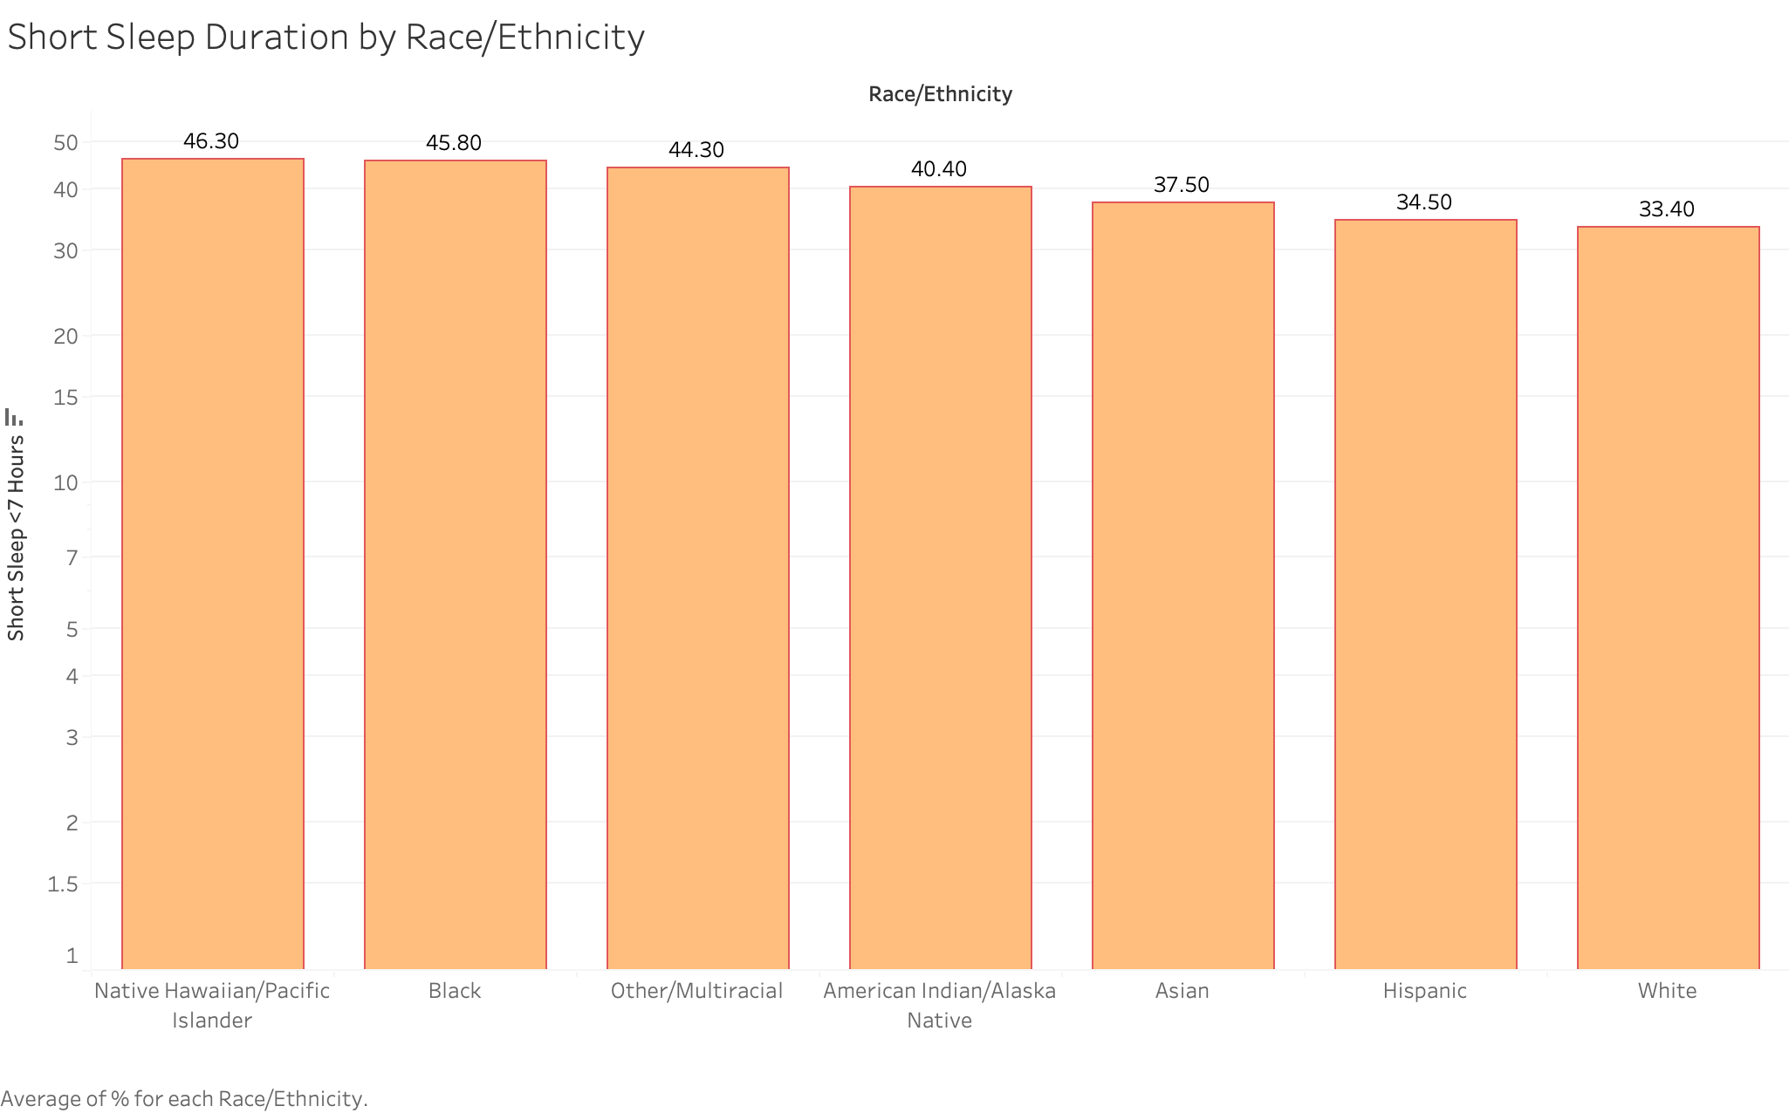

Slide 3
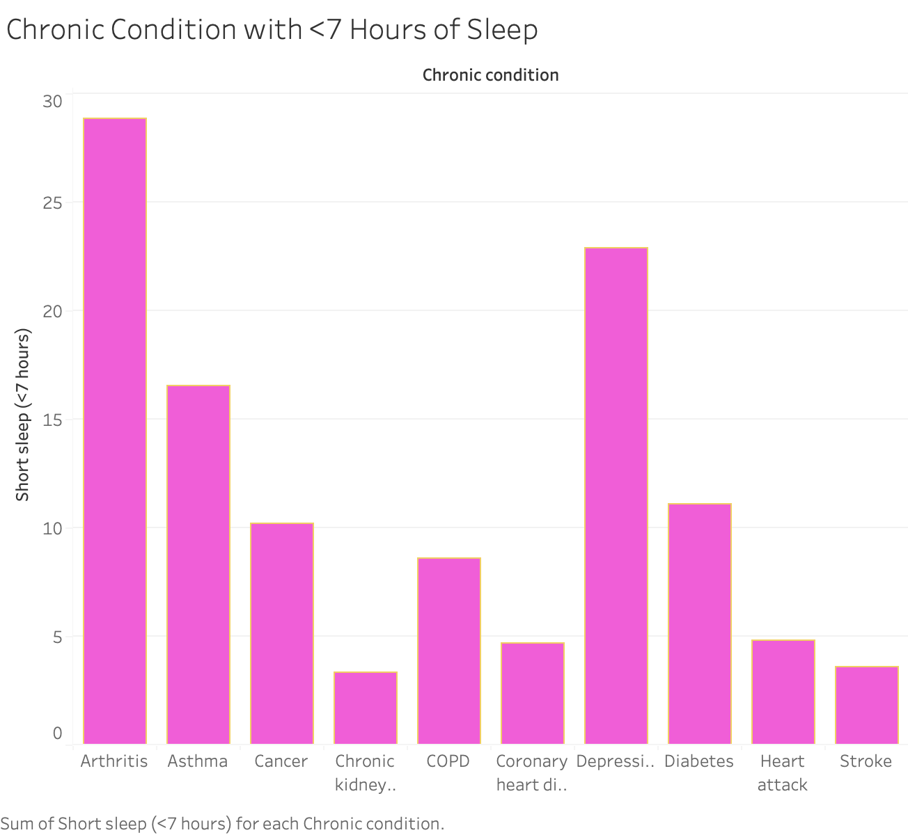

Slide 4
